Slide 1
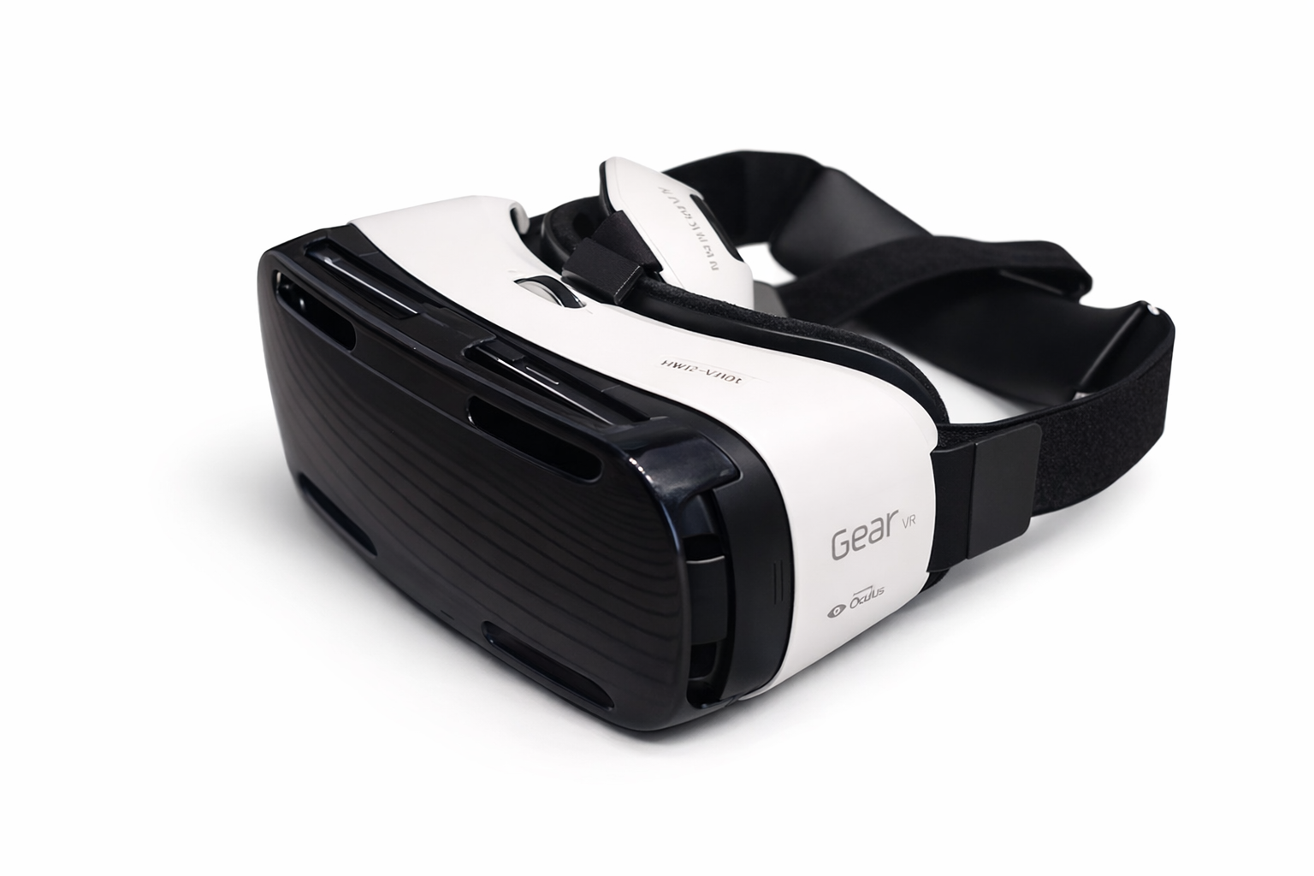
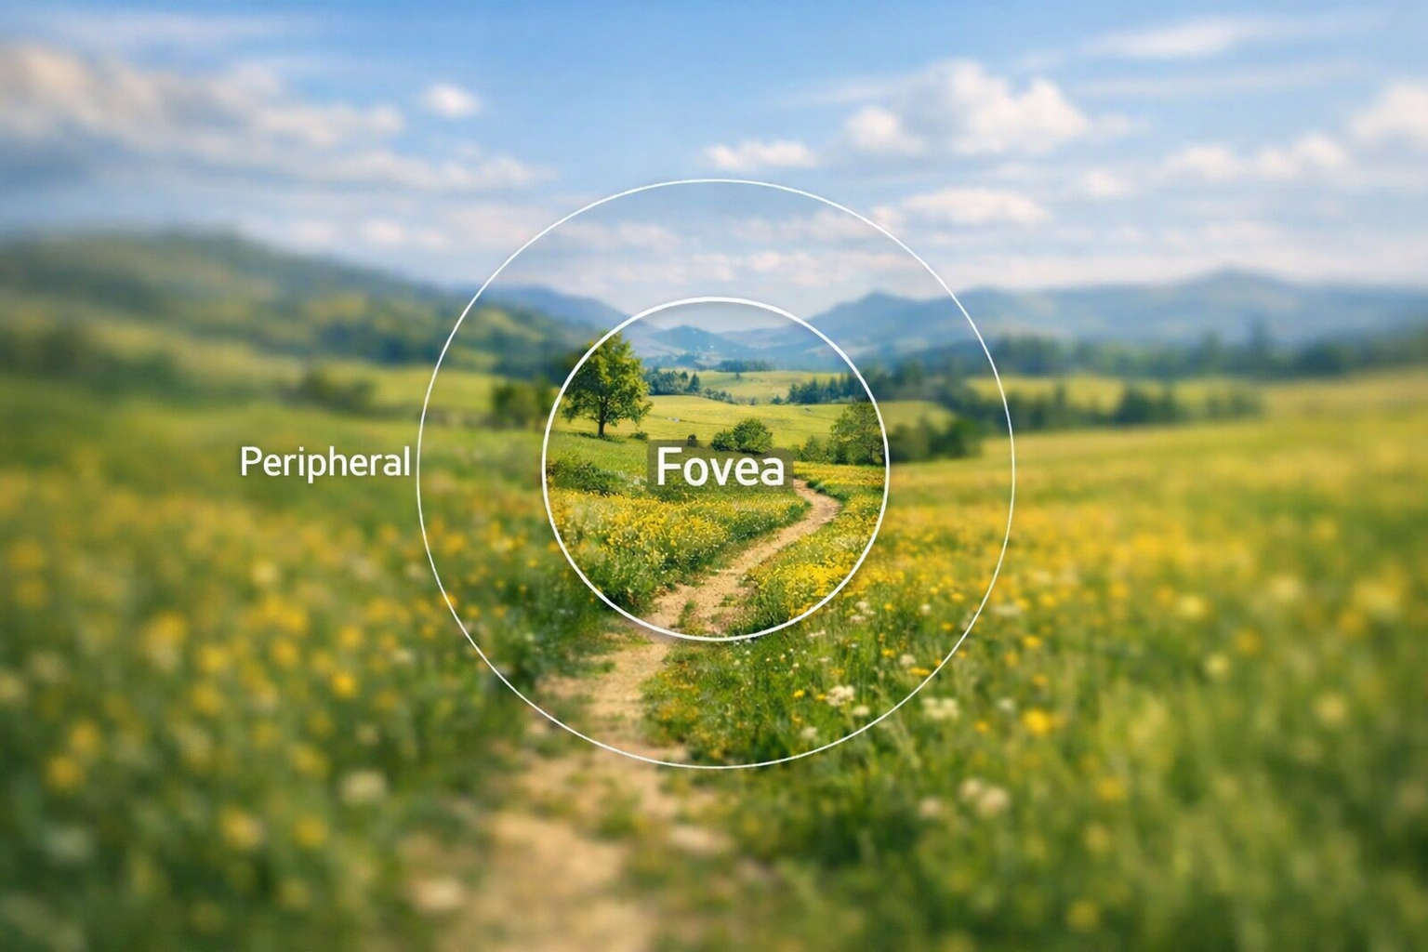
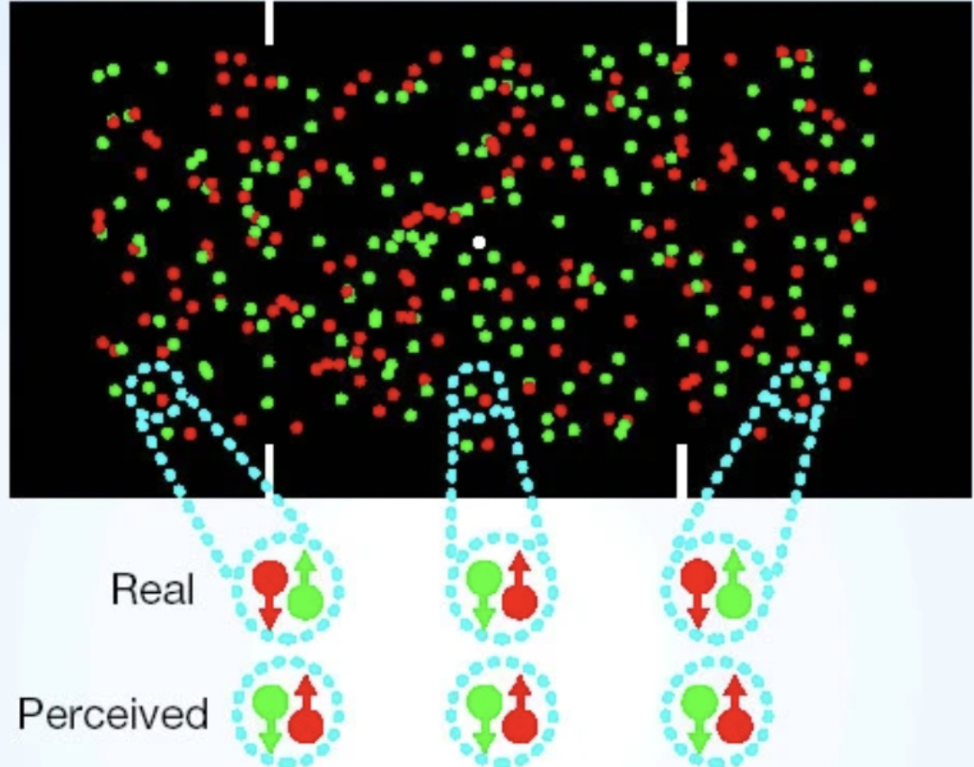

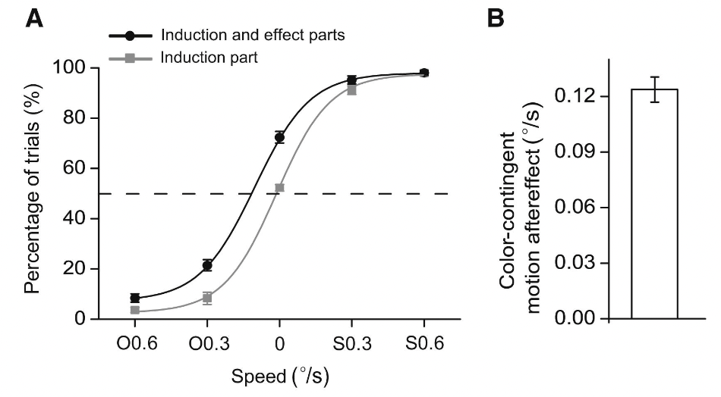
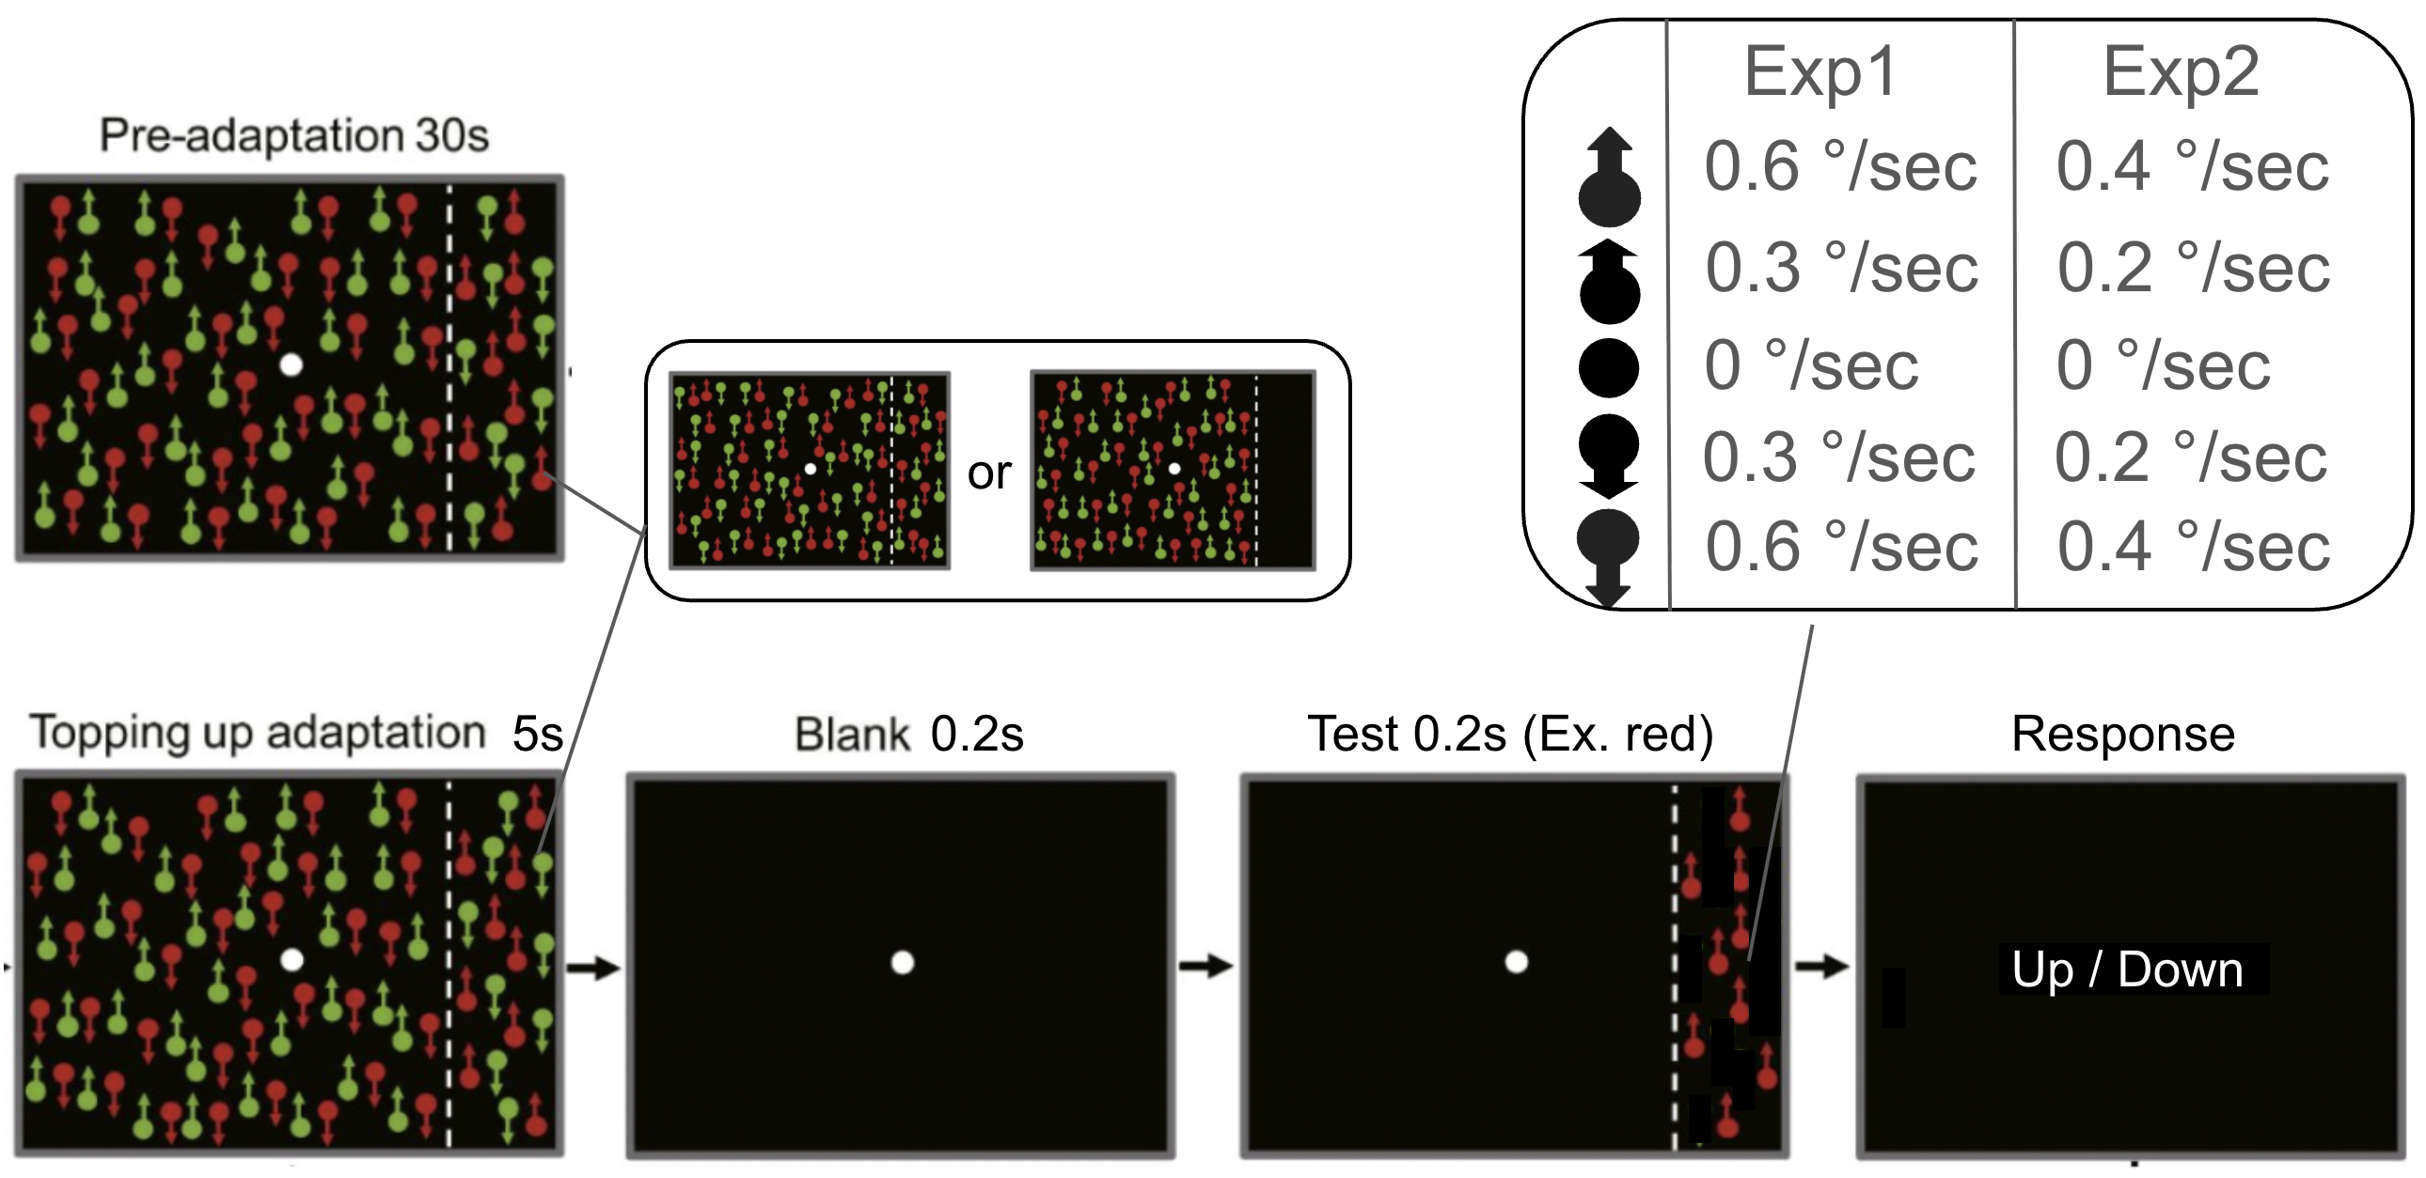
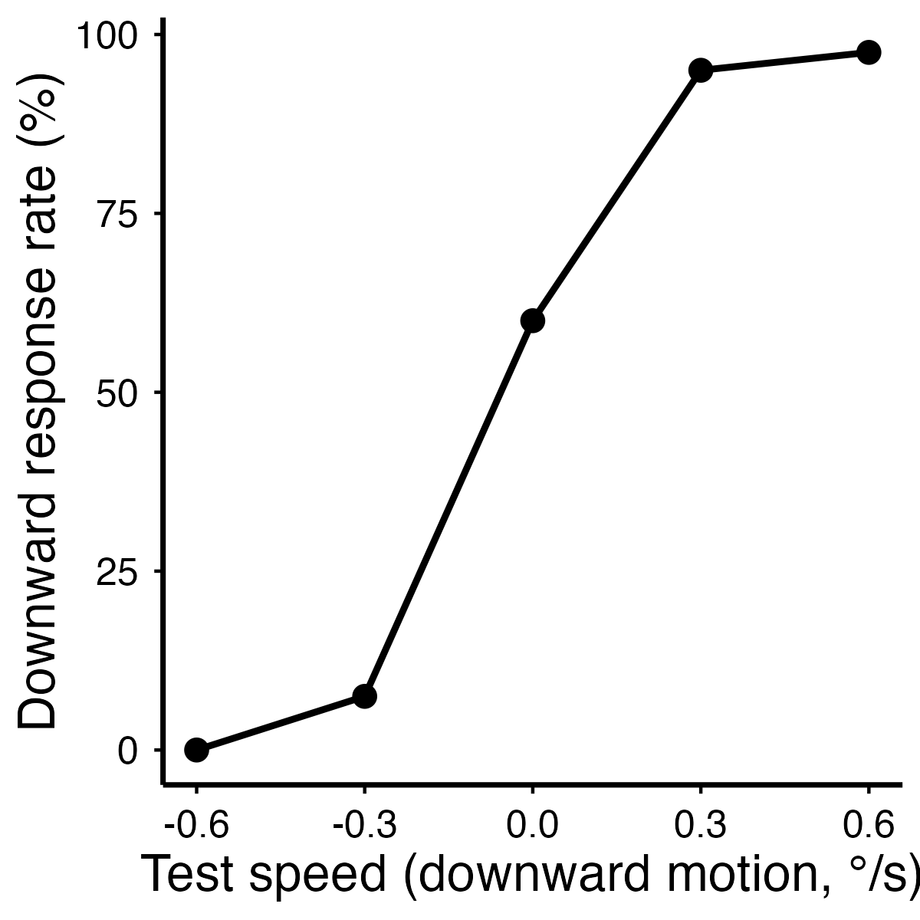
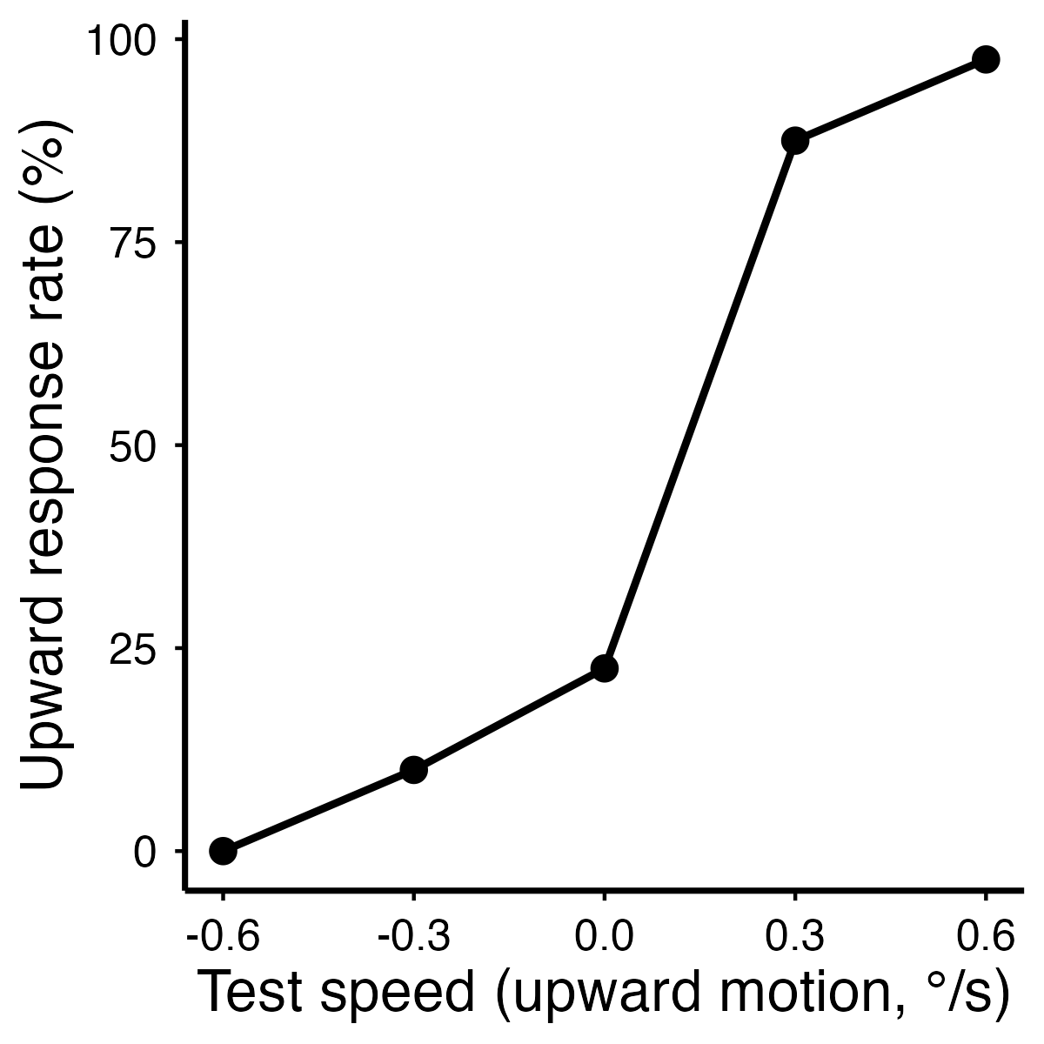
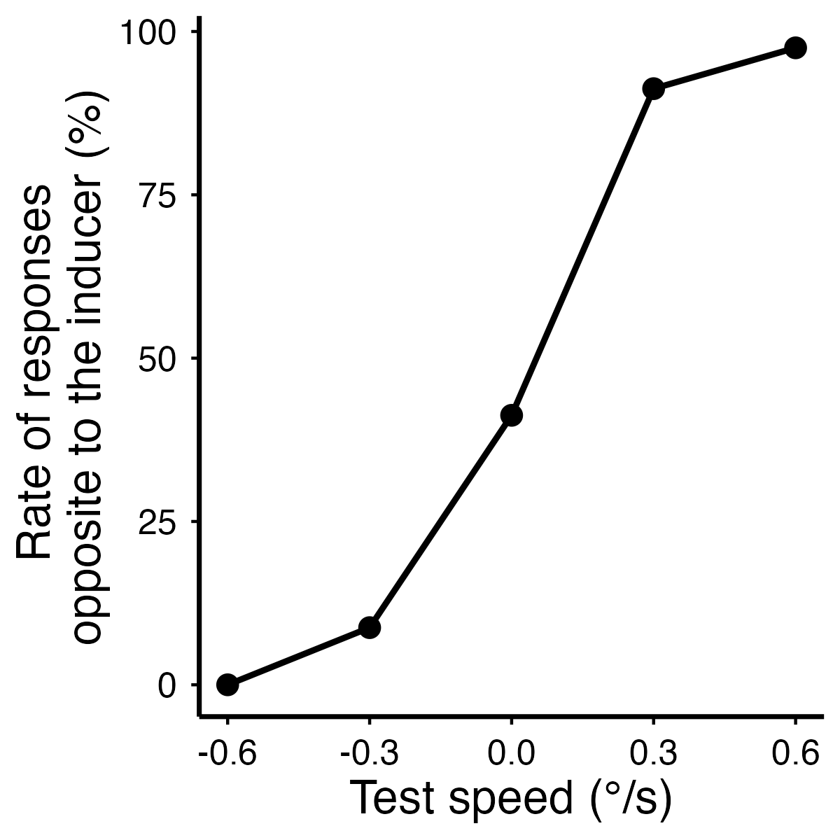
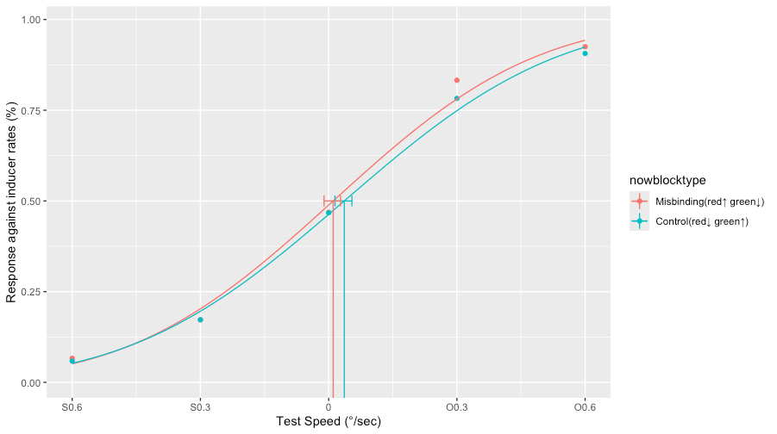
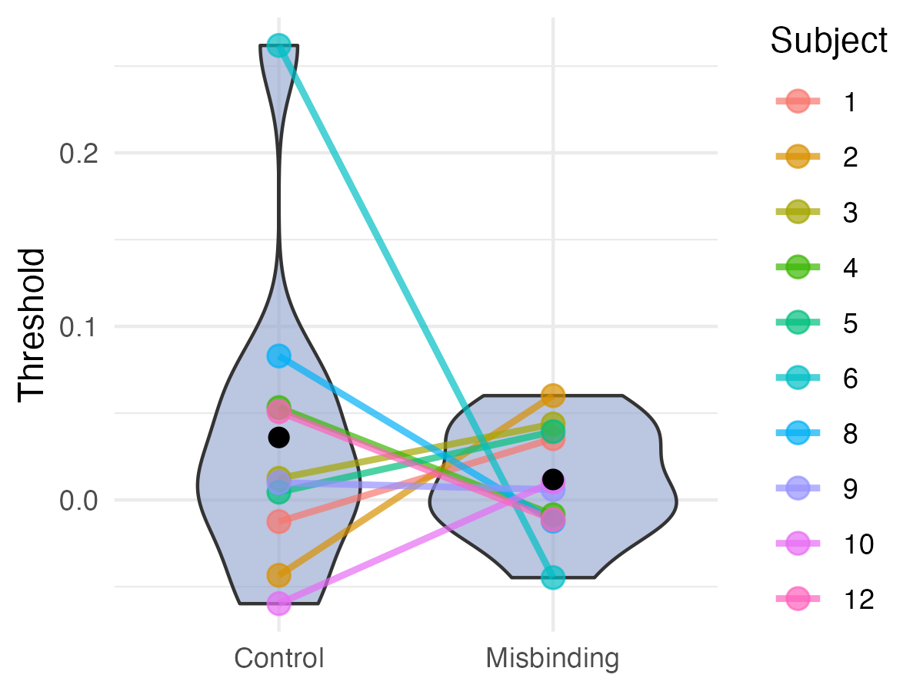
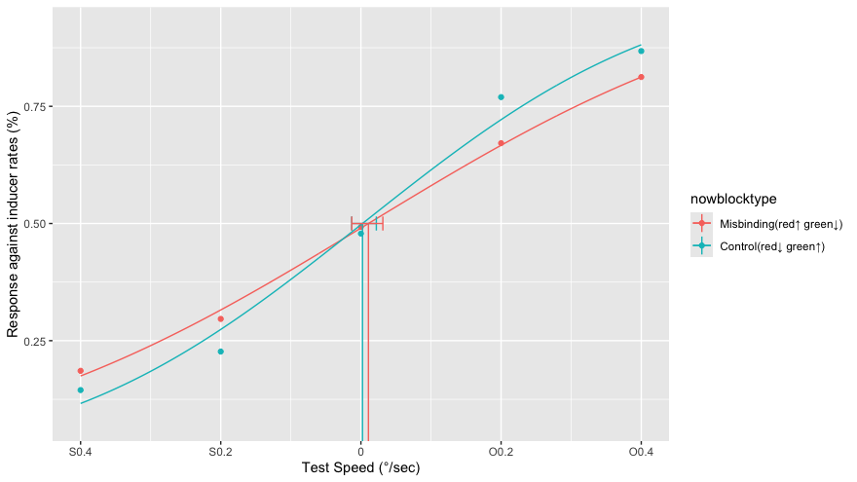
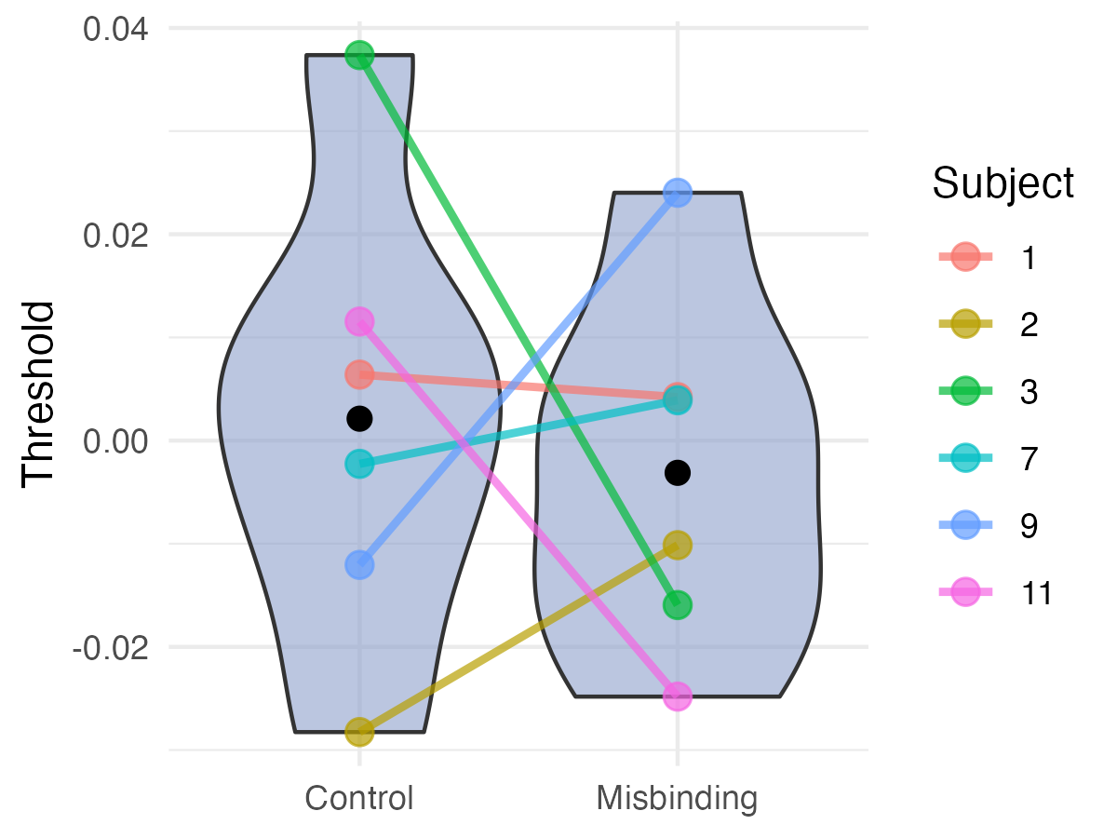
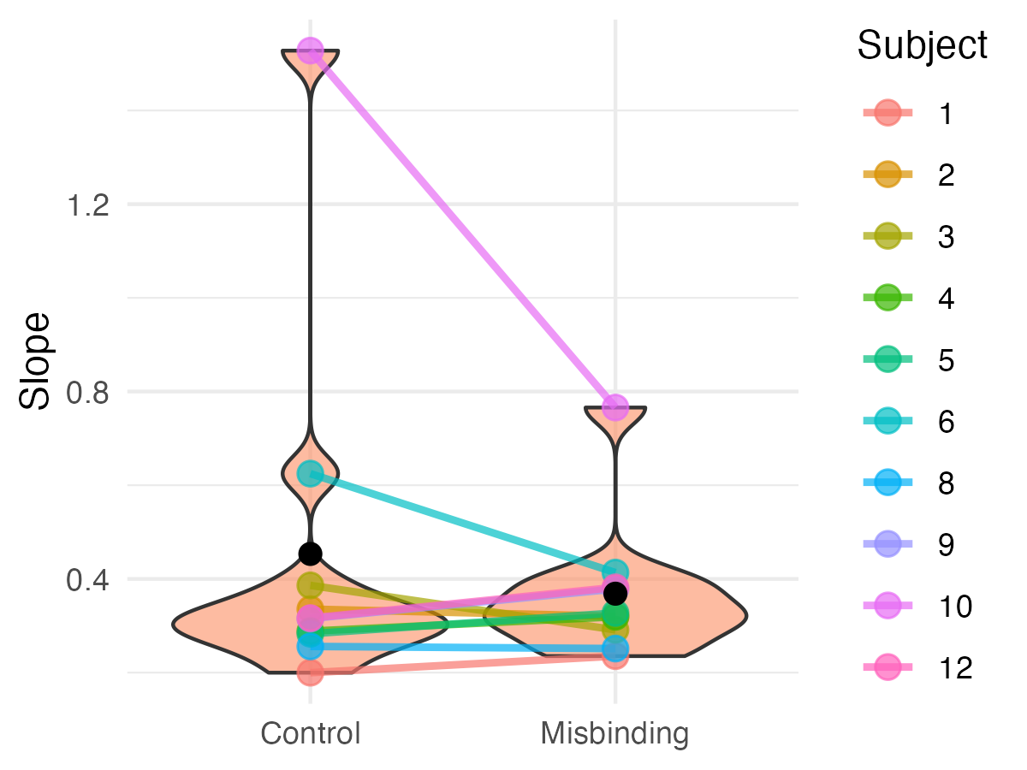
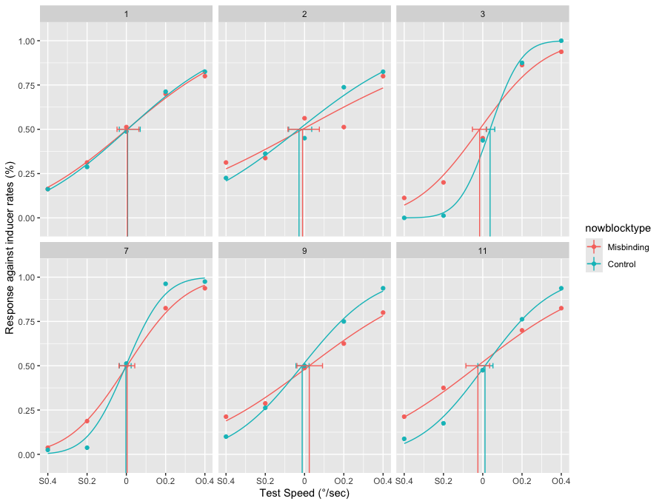
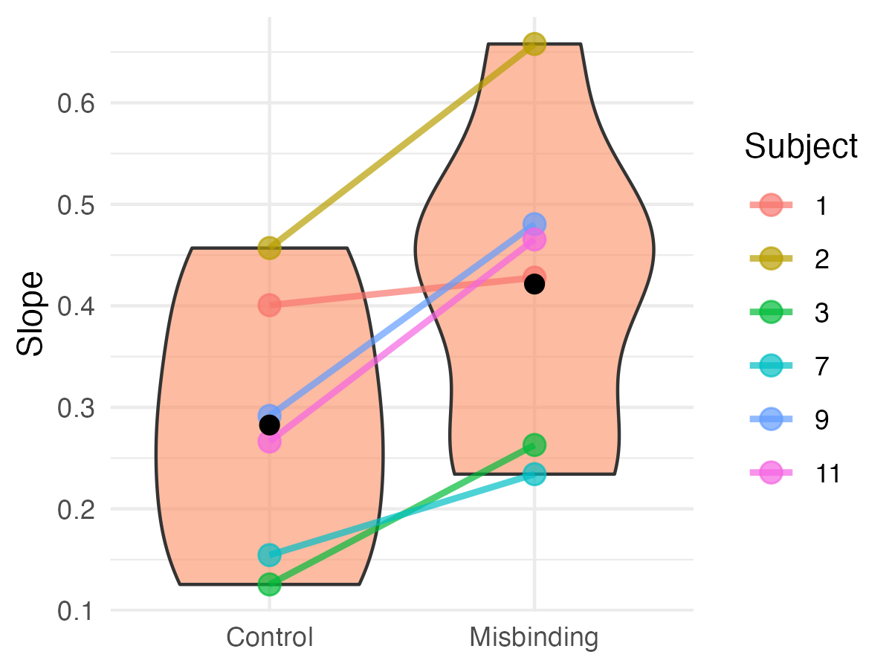
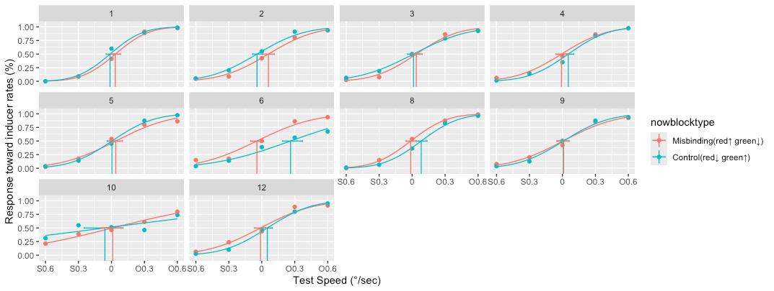

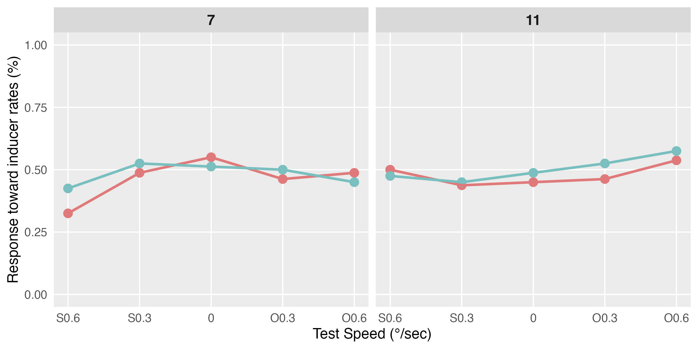
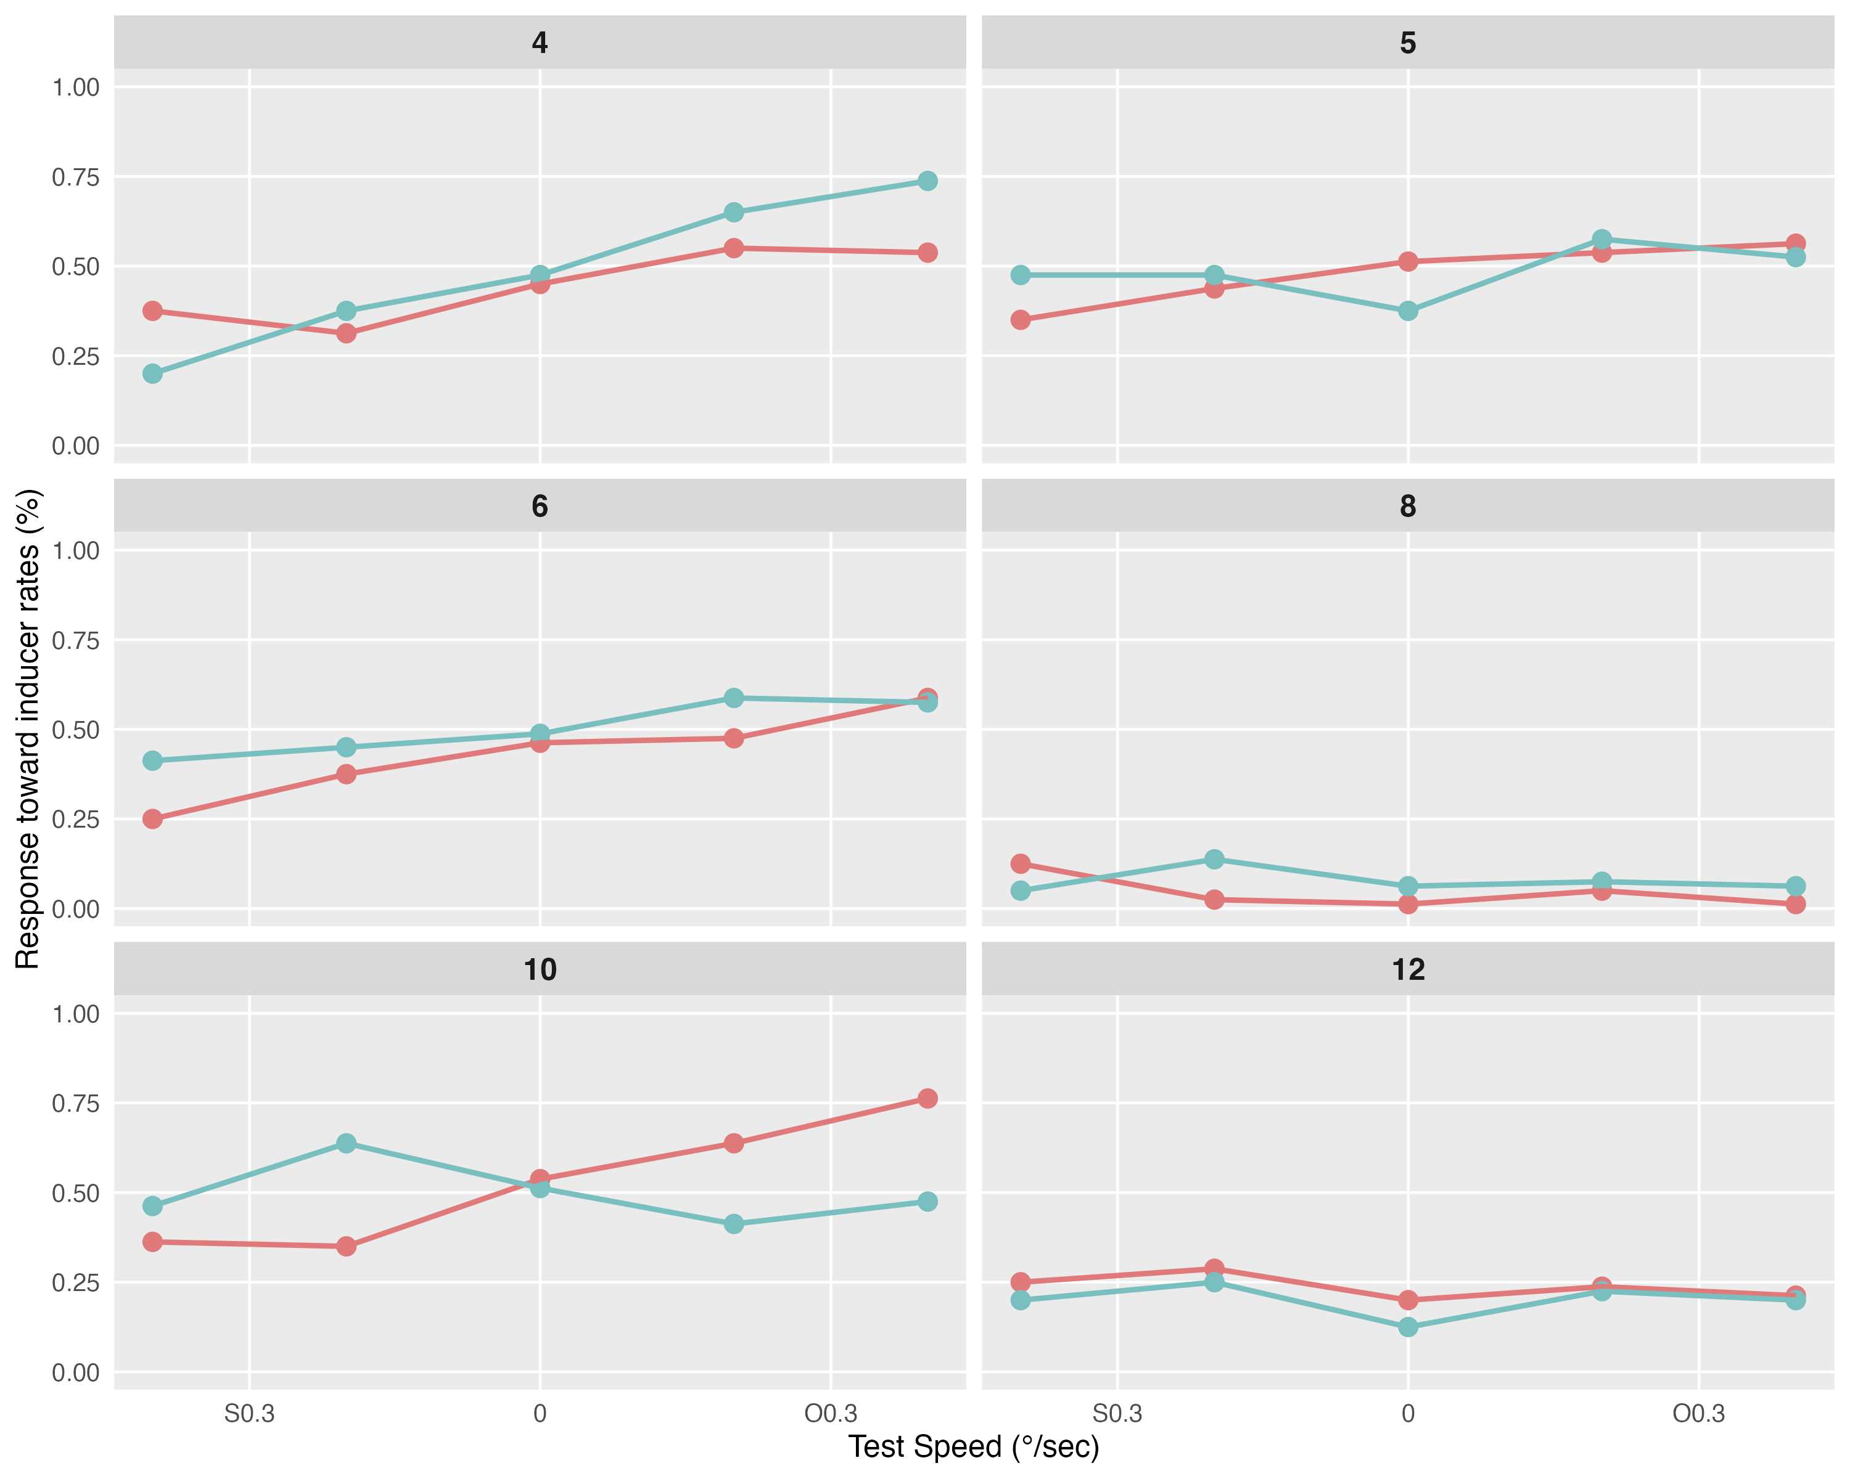
Perceptual Metamers For Gaze-Dependent Displays:
Peripheral Color–Motion Misbinding
Without Robust Neural Adaptation
○Lana Okubo¹ ²・Shin’ya Nishida¹ (¹Kyoto University ²Japan Society for the Promotion of Science )
AVS2026
✉ lanaokubo@gmail.com
Color–motion mis-binding in peripheral vision
Reduced peripheral resolution :
"metamer" for gaze-contingent display
Color-Motion misbinding :
a stronger metamer?
Color-contingent motion aftereffects
induced by the misbinding
Misbinding
Control
Wu et al., 2004
Zhang et al., 2014
Measuring the aftereffect of mis-binding
Experiments (N=12 each)
Analysis
Misbinding Control
Example of Sub1, Misbinding cond.
X°
X°
Test color = red Test color = green
X°
blank
v
v
Induce
part
Effect
part
+ =
v
×40
×20
Display: LCD screen, 60 Hz, 1024×768 pixel (dots appeared within 20°×14°), 57 cm away
Dots: diameter: 0.1°, adaptor’s speed: 3°/sec, density: 8/1°square,
red (CIE (1931): x=0.637, y=0.349, 18.9 cd/m²) or green (x=0.334, y=0.535, 18.2 cd/m²)
Participants: Twelve for each experiment, screened with the Ishihara Test
Fitting: quickpsy package for R (Linares & López-Moliner, 2016) with a cumulative normal function (the lapse rate and guessing rate were fixed at 0)
Data Exclusion criteria: non-convergent psychometric fits,
chance-level performance in the fastest condition.
No conclusive evidence for aftereffects
Exp1
Exp2
BF10 = 0.37 (Inconclusive)
BF10 = 0.39 (Inconclusive)
BF10 = 0.44 (Inconclusive)
BF10 = 11.2 (Strong evidence)
Excluded data
Excluded data
Discussion
perceptual misbinding does not necessarily rely on feature-contingent adaptation effects within low-level motion processing,
as has been hypothesized.
Instead, misbinding may involve higher-level visual processing in which illusory feature bindings do not evoke adaptation
comparable to that induced by veridical stimuli.
These findings offer new insights into the mechanisms of peripheral metamers and have implications for the development of efficient gaze-dependent display technologies: while peripheral content is subjectively altered, it may not produce the same neural signatures as veridical stimuli.
Notes:
The misbinding/control were not counterbalanced in terms of color-motion pairing. CCMAEs based on veridical color–motion pairings are typically weaker than the non-color-contingent motion aftereffect, and aftereffects caused by the illusory percepts are also generally reduced relative to those induced by physically presented stimuli.

